Slide 1

(CSCA-203)
Knowledge Representation & Reasoning
Lecture Week 4/2: Forward & Backward Chaining
Farhad Muhammad Riaz
National University of Modern Languages

Slide 2
Example knowledge base
It is a crime for an American to sell weapons to hostile nations:
  American(x) ∧ Weapon(y) ∧ Sells(x,y,z) ∧ Hostile(z) ⇒ Criminal(x)
Nono has some missiles
∃x Owns(Nono,x) ∧ Missile(x)
  Owns(Nono,M₁) ∧ Missile(M₁)
All of its missiles were sold to it by Colonel West
  Missile(x) ∧ Owns(Nono,x) ⇒ Sells(West,x,Nono)
Missiles are weapons:
  Missile(x) ⇒ Weapon(x)
An enemy of America counts as “hostile”:
  Enemy(x,America) ⇒ Hostile(x)
West is American
  American(West)
The country Nono is an enemy of America
  Enemy(Nono,America)

Slide 3
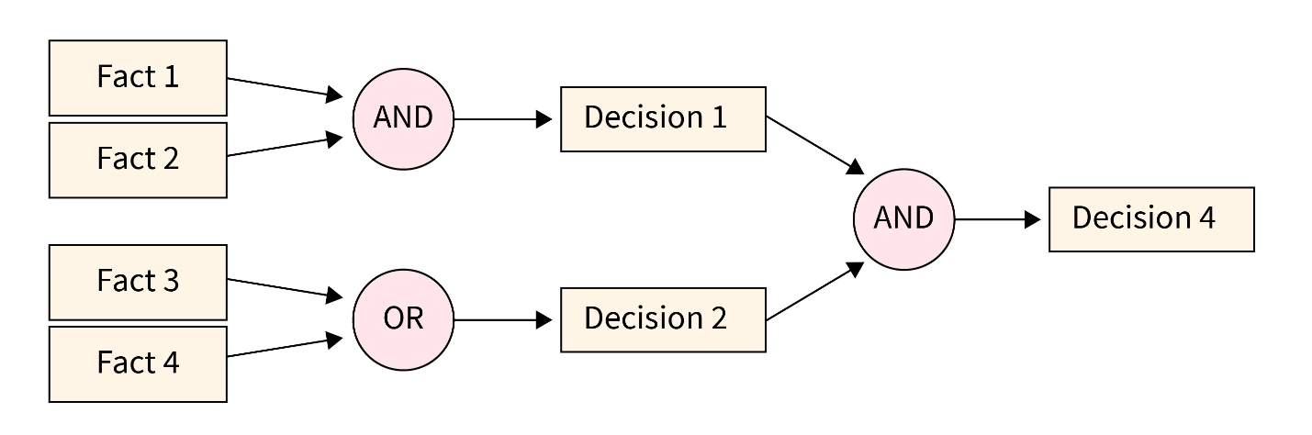
Forward Chaining
Forward chaining is a type of reasoning in which atomic clauses in a knowledge base are used to retrieve more data in the forward path using inference principles (Modus Ponens).

Slide 4
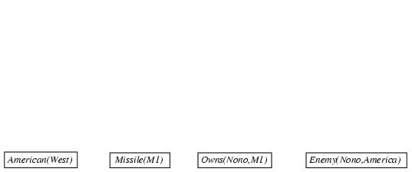
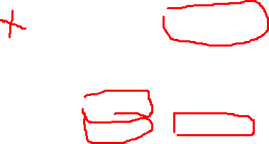
Forward chaining proof
  American(x) ∧ Weapon(y) ∧ Sells(x,y,z) ∧ Hostile(z) ⇒ Criminal(x)
  Owns(Nono,M₁) ∧ Missile(M₁)
  Missile(x) ∧ Owns(Nono,x) ⇒ Sells(West,x,Nono)
  Missile(x) ⇒ Weapon(x) Enemy(x,America) ⇒ Hostile(x)
  American(West) Enemy(Nono,America)

Slide 5
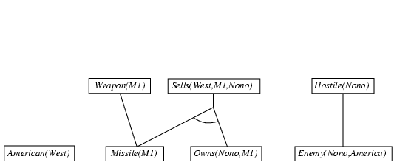
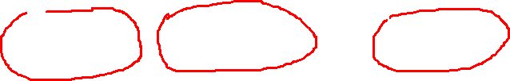
Forward chaining proof
  American(x) ∧ Weapon(y) ∧ Sells(x,y,z) ∧ Hostile(z) ⇒ Criminal(x)
  Owns(Nono,M₁) ∧ Missile(M₁)
  Missile(x) ∧ Owns(Nono,x) ⇒ Sells(West,x,Nono)
  Missile(x) ⇒ Weapon(x) Enemy(x,America) ⇒ Hostile(x)
  American(West) Enemy(Nono,America)

Slide 6
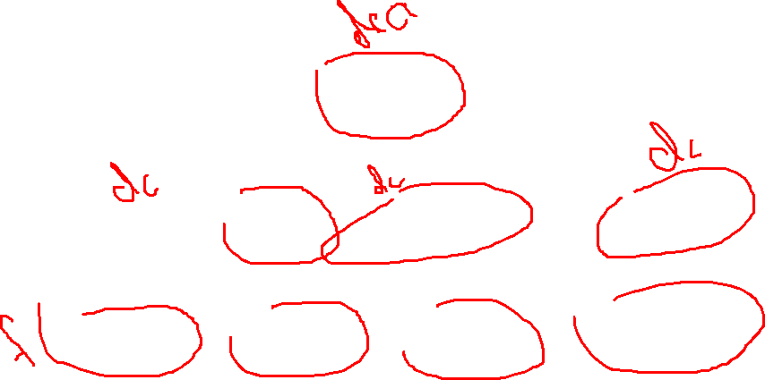
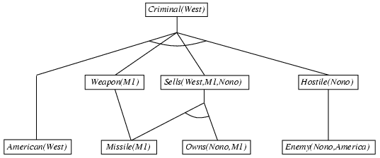
Forward chaining proof
  American(x) ∧ Weapon(y) ∧ Sells(x,y,z) ∧ Hostile(z) ⇒ Criminal(x)
  Owns(Nono,M₁) ∧ Missile(M₁)
  Missile(x) ∧ Owns(Nono,x) ⇒ Sells(West,x,Nono)
  Missile(x) ⇒ Weapon(x) Enemy(x,America) ⇒ Hostile(x)
  American(West) Enemy(Nono,America)

Slide 7
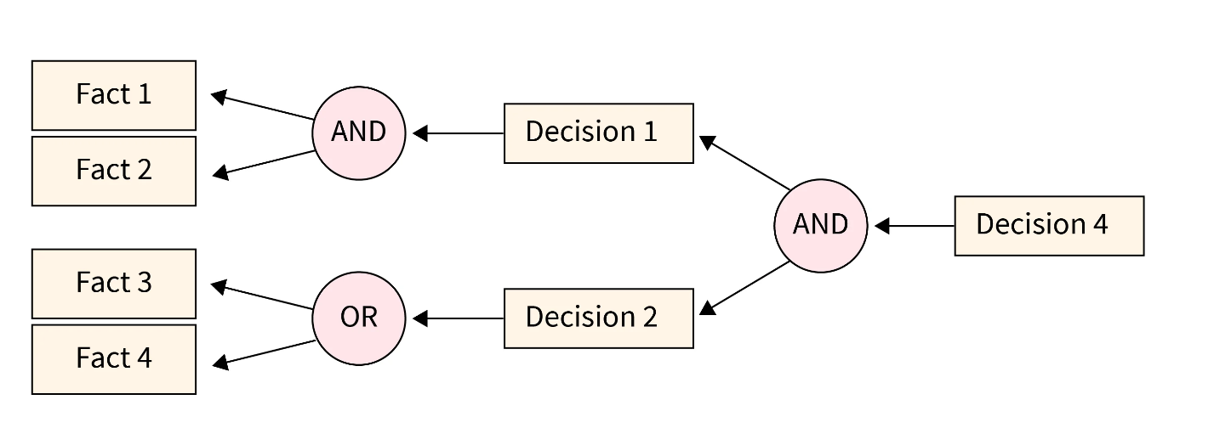
Backward Chaining
Backward Chaining, also known as backward reasoning, is an inference engine reasoning method that begins with an imagined objective. It employs backtracking to discover the most optimum method for dispute resolution or to achieve the target state, in which the search begins from the outcome and travels back to comprehend the circumstances from which it came

Slide 8

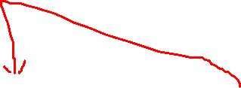
Backward chaining example
  American(x) ∧ Weapon(y) ∧ Sells(x,y,z) ∧ Hostile(z) ⇒ Criminal(x)
  Owns(Nono,M₁) ∧ Missile(M₁)
  Missile(x) ∧ Owns(Nono,x) ⇒ Sells(West,x,Nono)
  Missile(x) ⇒ Weapon(x) Enemy(x,America) ⇒ Hostile(x)
  American(West) Enemy(Nono,America)

Slide 9
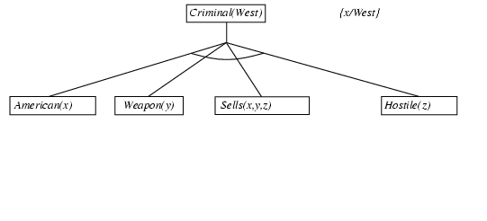

Backward chaining example
  American(x) ∧ Weapon(y) ∧ Sells(x,y,z) ∧ Hostile(z) ⇒ Criminal(x)
  Owns(Nono,M₁) ∧ Missile(M₁)
  Missile(x) ∧ Owns(Nono,x) ⇒ Sells(West,x,Nono)
  Missile(x) ⇒ Weapon(x) Enemy(x,America) ⇒ Hostile(x)
  American(West) Enemy(Nono,America)

Slide 10
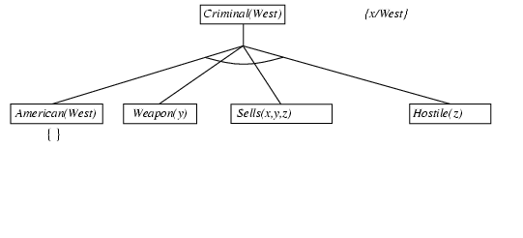
Backward chaining example
  American(x) ∧ Weapon(y) ∧ Sells(x,y,z) ∧ Hostile(z) ⇒ Criminal(x)
  Owns(Nono,M₁) ∧ Missile(M₁)
  Missile(x) ∧ Owns(Nono,x) ⇒ Sells(West,x,Nono)
  Missile(x) ⇒ Weapon(x) Enemy(x,America) ⇒ Hostile(x)
  American(West) Enemy(Nono,America)

Slide 11
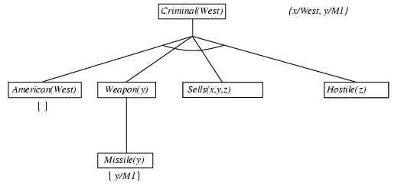
Backward chaining example
  American(x) ∧ Weapon(y) ∧ Sells(x,y,z) ∧ Hostile(z) ⇒ Criminal(x)
  Owns(Nono,M₁) ∧ Missile(M₁)
  Missile(x) ∧ Owns(Nono,x) ⇒ Sells(West,x,Nono)
  Missile(x) ⇒ Weapon(x) Enemy(x,America) ⇒ Hostile(x)
  American(West) Enemy(Nono,America)

Slide 12
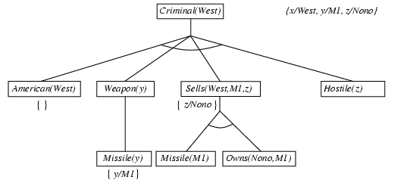
Backward chaining example
  American(x) ∧ Weapon(y) ∧ Sells(x,y,z) ∧ Hostile(z) ⇒ Criminal(x)
  Owns(Nono,M₁) ∧ Missile(M₁)
  Missile(x) ∧ Owns(Nono,x) ⇒ Sells(West,x,Nono)
  Missile(x) ⇒ Weapon(x) Enemy(x,America) ⇒ Hostile(x)
  American(West) Enemy(Nono,America)

Slide 13
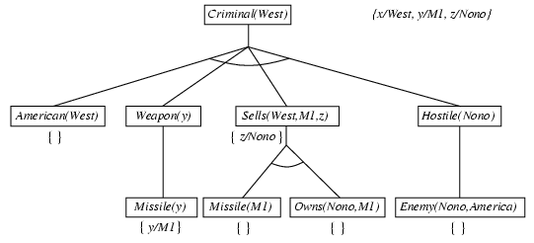
Backward chaining example
  American(x) ∧ Weapon(y) ∧ Sells(x,y,z) ∧ Hostile(z) ⇒ Criminal(x)
  Owns(Nono,M₁) ∧ Missile(M₁)
  Missile(x) ∧ Owns(Nono,x) ⇒ Sells(West,x,Nono)
  Missile(x) ⇒ Weapon(x) Enemy(x,America) ⇒ Hostile(x)
  American(West) Enemy(Nono,America)

